Slide 1
Physical, Mental, Emotional, Social Health
7th grade Health

Slide 2
Physical Health
What is it?
Refers to how well your body functions.
What are some things that affect your physical health negatively?
How?
What are things that affect your physical health positively?

Slide 3
Physical Health
Eating Healthy
Exercise
Proper Medical Care
Proper Dental Care
SLEEP

Slide 4
Mental Health
What is it?
Being comfortable with yourself, with others, and with your surroundings.
What are some things that affect your mental health negatively?
How?
What are some things that affect your mental health positively?

Slide 5
Mental Health
Eliminate stressors
Can affect you later on
Healthful Mental Habits
(positive self talk)
Physical Exercise
releases endorphins

Slide 6
Emotional Health
What is it?
Refers to how you react to events in your life.
What are some things that affect your emotional health negatively?
How?
What are some things that affect your emotional health positively?

Slide 7
Emotional Health
Positive self talk
Healthy views of others
Meditation
Deep breathing
Values and morals
Reducing stressors

Slide 8
Social Health
What is it?
Refers to how well you get along with others.
What are some things that affect your social health negatively?
How?
What are some things that affect your social health positively?

Slide 9
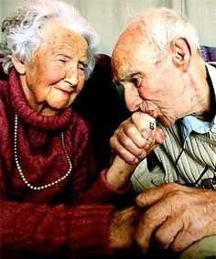
Social Health
The Golden Rule
Accepting differences
Communication
Vulnerability
Awareness
Social Networks
Healthy Relationships

